Slide 1
PHYS 8750 Final Presentation
Alex Murtha
12/4/2020

Slide 2
Overview
Plan
Run SU2 program on Palmetto Cluster
Compare different numerical schemes
Derive truncation error/stability analysis for each scheme
Reality
Ran into issue on supercomputer
Built case but could not run it
Could not mathematically derive error/stability criteria

Slide 3



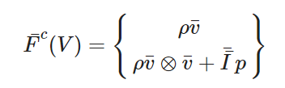
SU2 Introduction
Many different solvers
Most commonly used:
Incompressible Euler
Incompressible Navier Stokes
General Euler
General Navier Stokes
Unsteady flow
Figure 2: Incompressible Euler equations [1]
Figure 1: Test cases/solvers within SU2
[1] SU2 Documentation: https://su2code.github.io/docs_v7/Theory/

Slide 4
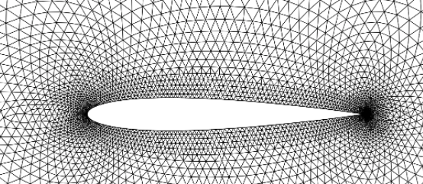
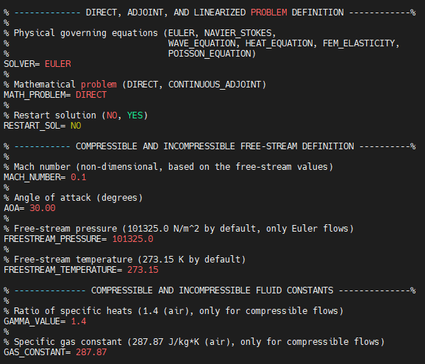
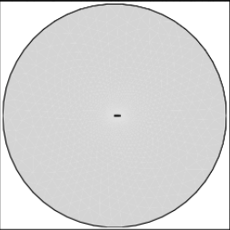
SU2 Test Case
Flow
direction
Incompressible Euler equations
Flow over an airfoil
30° angle of attack
Standard atmosphere
Mach = 0.1 -> (velocity = 34.3 m/s)
30°
Figure 3: Close-up view of mesh characteristics for airfoil test [1]
Flow
direction
30°
Figure 4: Wide view of mesh to show boundary conditions [1]
Figure 5: Screenshot of .cfg file in SU2 configured for test case [1]
[1] SU2 Documentation: https://su2code.github.io/docs_v7/Quick-Start/

Slide 5
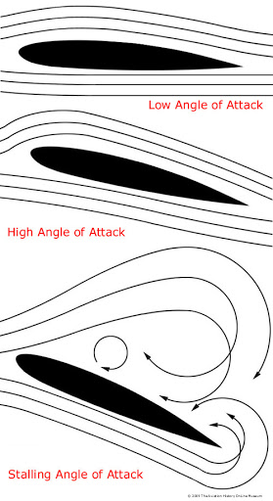
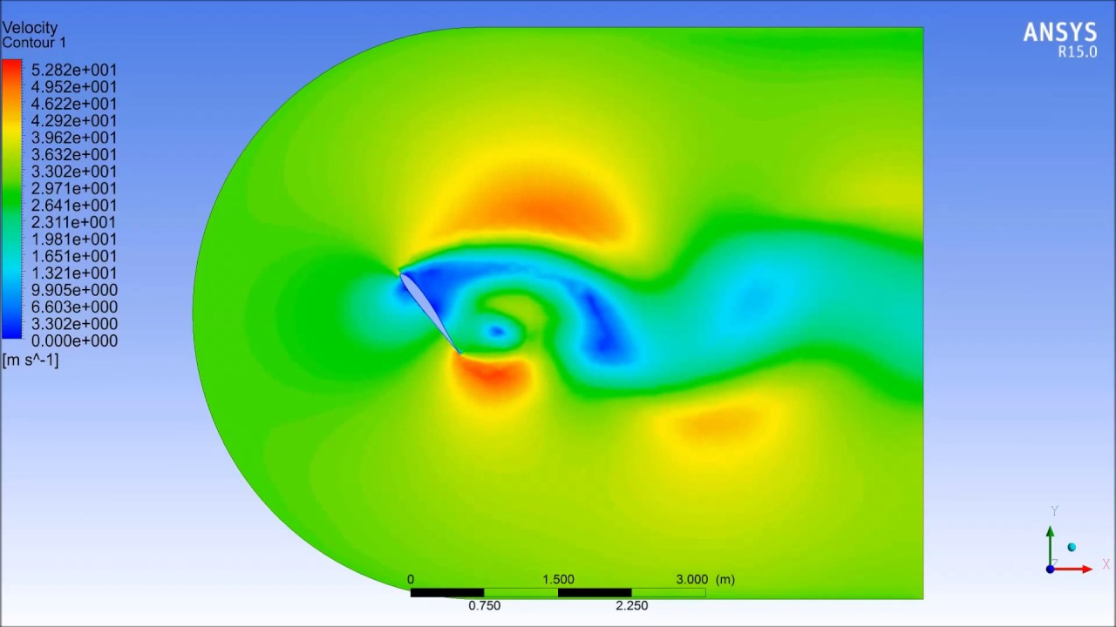
Expected Results
Figure 6: Ansys result of high angle of attack for airfoil [2]
Figure 7: Visualization of high angle of attack situation [1]
[1] The Aviation History Online Museum “Angle of Attack” http://www.aviation-history.com/theory/angle_of_attack.htm
[2] https://www.youtube.com/watch?v=Yvs3QvUknFQ

Slide 6
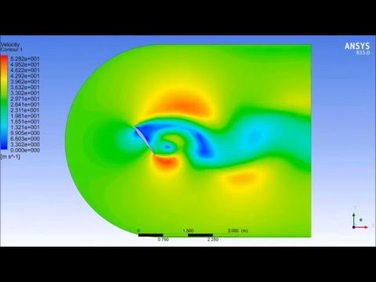
Expected Results
https://www.youtube.com/watch?v=Yvs3QvUknFQ

Slide 7
Looking for:
Performance of each method
Number of iterations necessary
Final convergence residual
Viscous effects observed
Capturing of vortex shedding

Slide 8
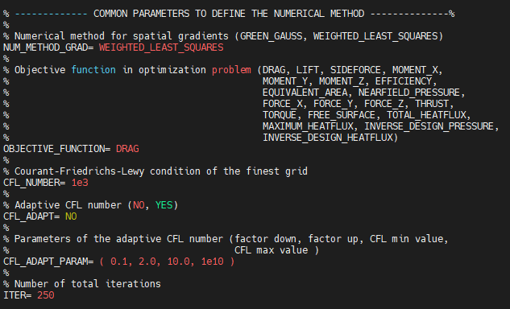
Further research
Successfully operate the Palmetto Cluster to achieve results
Determine why CFL >> 1.0 is frequently used
Understand adaptive CFL parameters
Figure 8: Example of .cfg file for general Euler solution

Slide 9
Numerical Methods Analyzed
JST (Jameson-Schmidt-Turkel)
Center-space scheme
Roe
Upwind Scheme
HLLC (Harten Lax van Leer – Contact)
Upwind Scheme
All methods are Flux-limited methods

Slide 10



JST Method
Solves advection/1-D incompressible Euler equation
With state vector w and flux vector f(w)
For uniform x-grid, the finite volume scheme is
[1]Antony Jameson “The Origins and Further Development of the Jameson-Schmidt-Turkel (JST) Scheme” Stanford University 2015, http://aero-comlab.stanford.edu/Papers/presentation_jst_2015.pdf

Slide 11



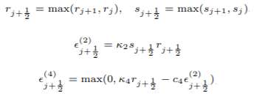
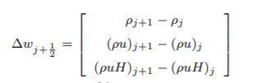
JST Method
For uniform x-grid, the finite volume scheme is
Flux across j & j+1 boundary
Dissipative flux correction term
Pressure sensor in program
Dissipative coefficient solver
[1]Antony Jameson “The Origins and Further Development of the Jameson-Schmidt-Turkel (JST) Scheme” Stanford University 2015, http://aero-comlab.stanford.edu/Papers/presentation_jst_2015.pdf

Slide 12

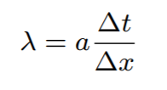
JST Method
Precursor to JST Method:
Issue:
n+1 time step on both sides
Solution:
Guess at next time step (iterative solution)
Figure 7: Simplified form of 1-D in space JST numerical solution [1]
S+1
S+1
[1]Antony Jameson “The Origins and Further Development of the Jameson-Schmidt-Turkel (JST) Scheme” Stanford University 2015, http://aero-comlab.stanford.edu/Papers/presentation_jst_2015.pdf

